Slide 1
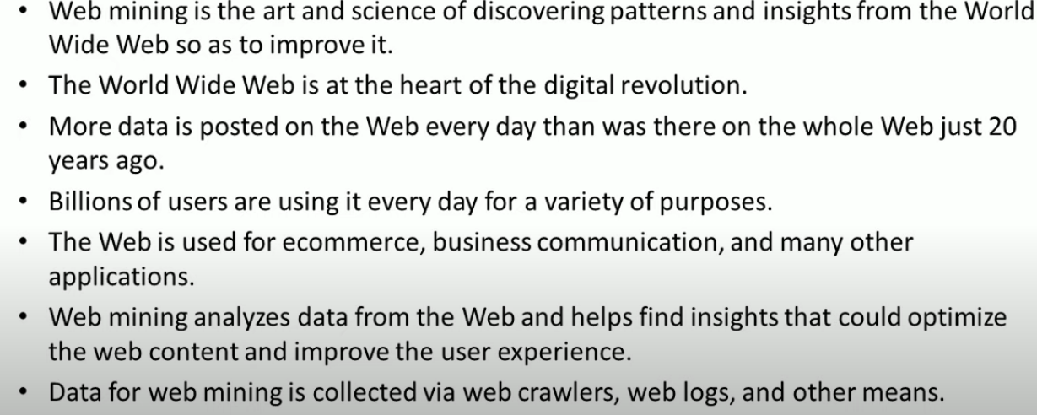
Web mining

Slide 2
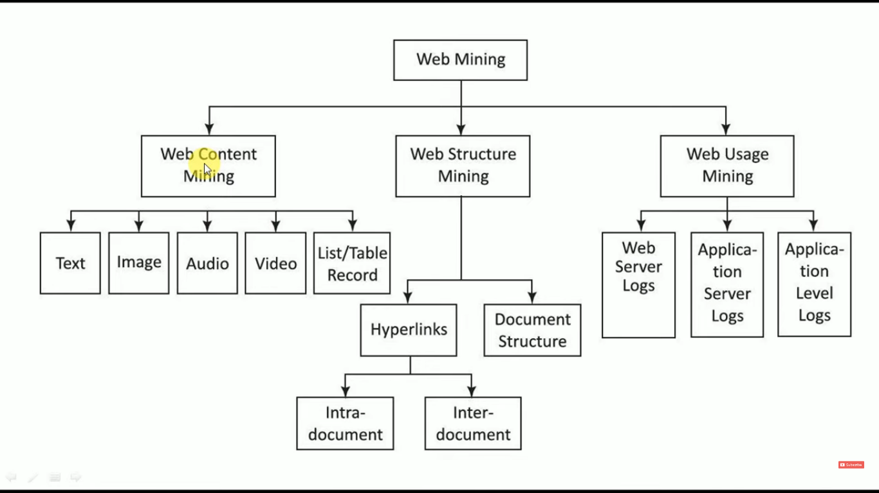

Slide 3
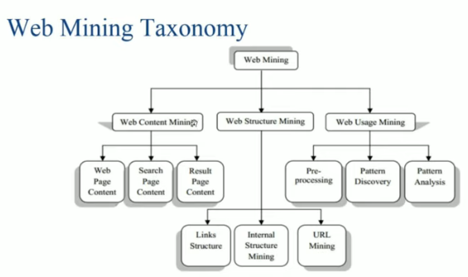


Slide 4


Web Content and Structure Mining

Slide 5
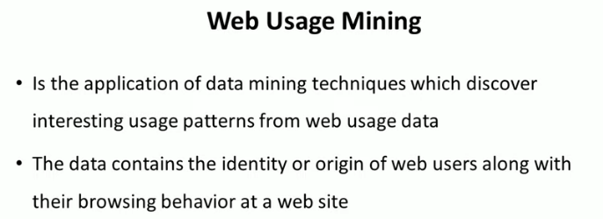

Slide 6
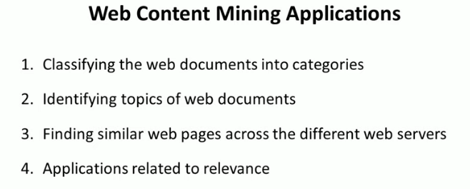
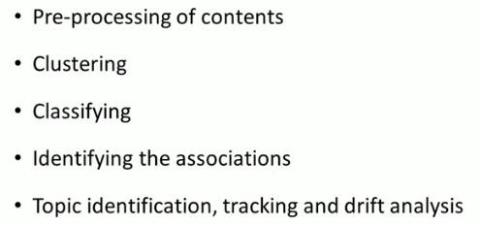

Slide 7
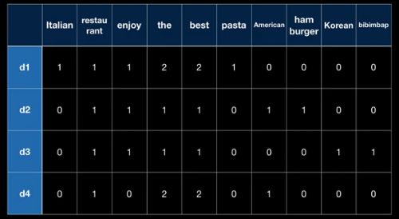
Bag of Words

Slide 8
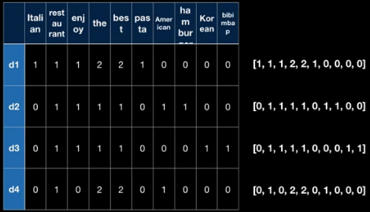
BoW – Doc Similarity

Slide 9

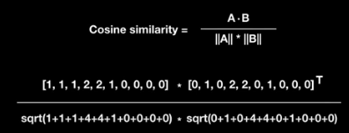

BoW – Cosine Similarity

Slide 10
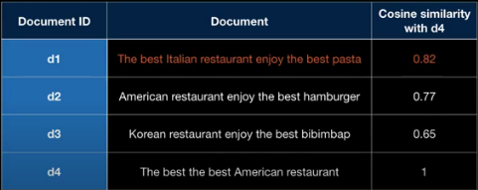
COSIM(Di,D4)

Slide 11
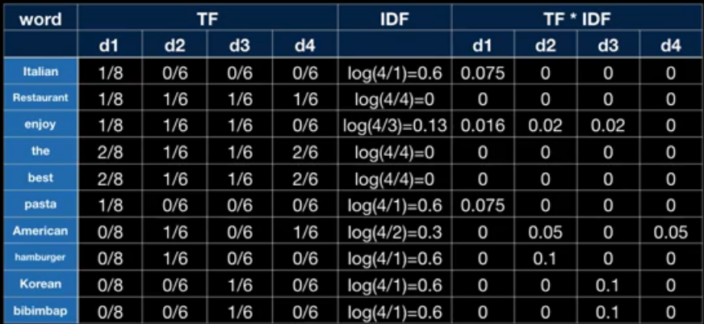
TF-IDF – Term Frequency Inverse Document Frequency

Slide 12
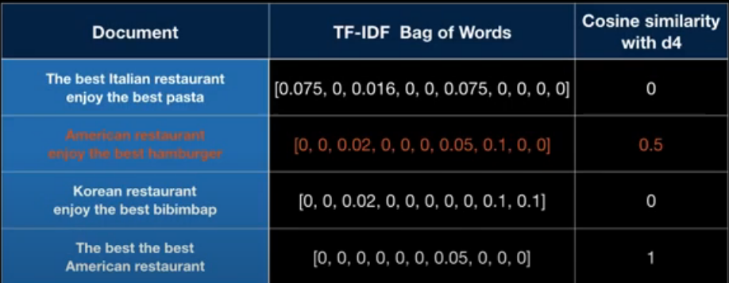
COSIM(TFIDF(Di),TFIDF(D4))

Slide 13


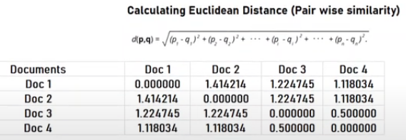

Slide 14



Slide 15

Packages in R

Slide 16

Pre-processing

Slide 17


Cosine Similarity

Slide 18

Similarity Matrix

Slide 19
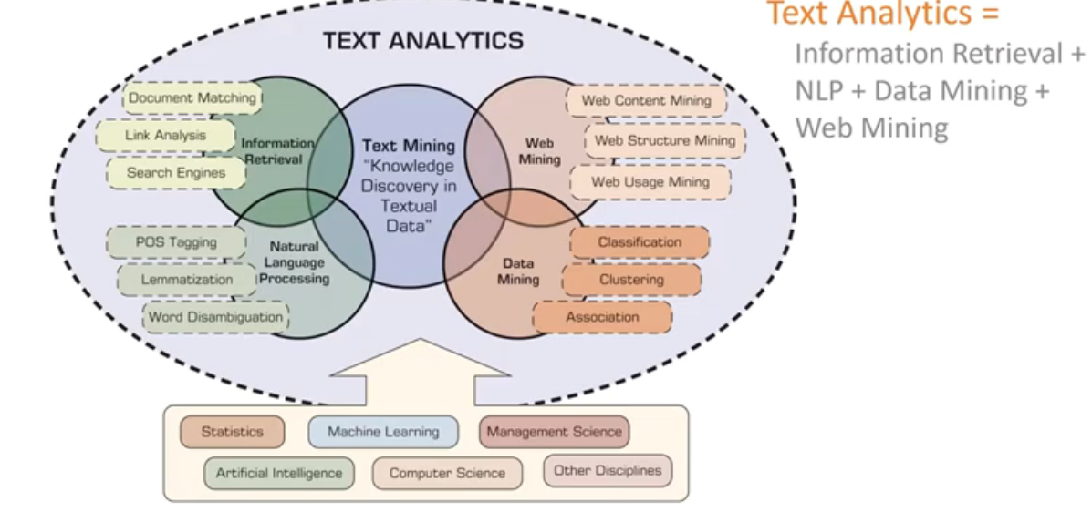
Text Mining vs Analytics

